Slide 1

F1 Overtakes analysis
Advanced Data Science 2024,
Relato Alessandro

Slide 2
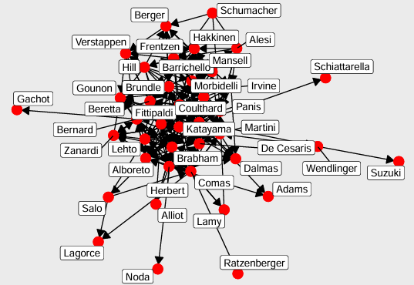
The graphs
The graphs represents the overtakes that happen during a season of Formula 1.
There are 26 graphs of the seasons from 1994 to 2020 and one general graph with all the seasons together.
All 27 are directed graph and every edge go from the overtaker to the overtaken.
Graph of the 1994 season
Graph | # of nodes | # of edges | Density | Reciprocity
Mean | 25,11 | 250,48 | 0,4378 | 0,4714
General | 161 | 3493 | 0,1356 | 0,4689

Slide 3
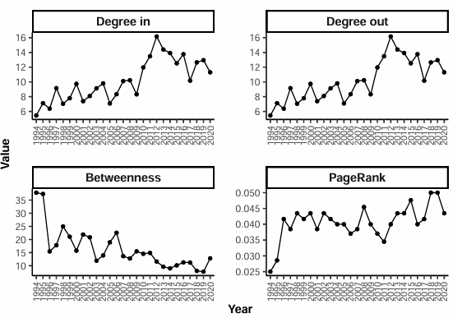
Centrality
I analyzed 3 type of centrality: degree, betweenness and PageRank.
The degree centrality analysis pointed out that the driver which was overtaken the most and the one who overtook the least were a mid-low field driver.
The driver that overtook the most is almost every year a mid field driver.
While the driver which was overtaken the least is or a top driver or a low-field driver.
During the years the degree centrality has increased till 2012 and then has decreased a little bit.
Progression of degree centrality during years

Slide 4
Centrality
The drivers with the lowest betweenness (0 for almost every year) are low field drivers with some exception of top drivers.
The ones with highest betweenness are always drivers from the middle of the grid.
During the years this centrality has decreased, with some peak a few times.
The highest values of PageRank always correspond to mid field drivers.
While the drivers with the lowest values some years are top drivers and some years are low field drivers.
This centrality, following the degree centrality, has increased during the years, but has not the flexion after the 2012.
Progression of betweenness centrality during years
Progression of PageRank centrality during years

Slide 5
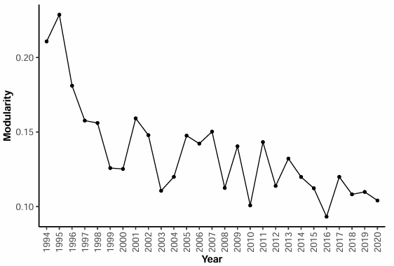
modularity
The modularity of the general graph is 0,1019.
The graphs have a positive value of modularity --> the nodes are organised in communities
The modularity value is pretty low --> the communities aren’t definied
Over the years the modularity has a decreasing trend
Modularity over the years

Slide 6
Connectivity
The general graph has an high connectivity, near 95%
This time there is no trend in the annual graphs, but all of them have a high connectivity. Some of them higher than the general one, others lower.
Some of them are fully conntected.
1994 | 1995 | 1996 | 1997 | 1998 | 1999 | 2000 | 2001 | 2002
72,50% | 94,29% | 79,17% | 100,0% | 95,65% | 100,0% | 100,0% | 92,31% | 95,65%
2003 | 2004 | 2005 | 2006 | 2007 | 2008 | 2009 | 2010 | 2011
83,33% | 92,00% | 88,00% | 96,30% | 92,31% | 100,0% | 92,00% | 92,59% | 89,66%
2012 | 2013 | 2014 | 2015 | 2016 | 2017 | 2018 | 2019 | 2020
100,0% | 100,0% | 95,65% | 100,0% | 96,00% | 83,33% | 100,0% | 100,0% | 100,0%
General
93,79%

Slide 7
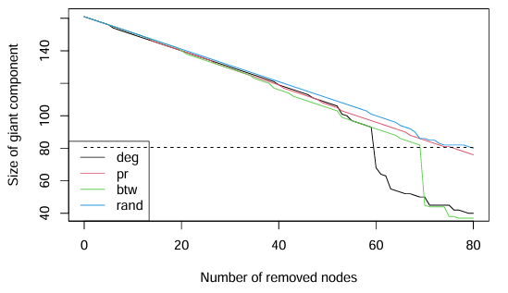
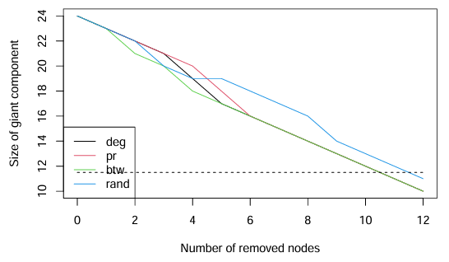
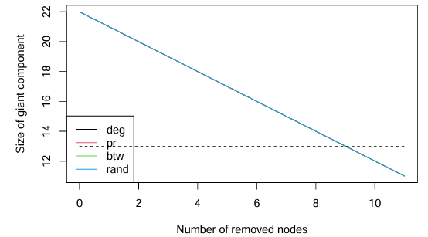
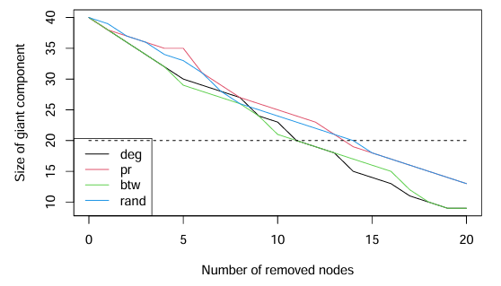
Resilience
I chose a sample of graphs to analyze with different connectivity percentages (82,3%, 100%, 72,5%).
All graphs are pretty resilient, the best attacks are the ones that follow the degree and the betweenness centrality.
The general graph has some key nodes which removal causes a drop, while in the others there is a linear reduction.
Percolation of the general graph
Percolation of the 2017 season
Percolation fo the 2008 season
Percolation of the 1994 season

Slide 8
Distances and diameters
General
3
11
All graphs (general and annuals) have short mean distances. The most surpising one is the general one that has far more nodes than the annual ones.
Also the diameters are very low.
With these data we can say that all the graphs are small world networks.
1994 | 1995 | 1996 | 1997 | 1998 | 1999 | 2000 | 2001 | 2002
2,32 | 2,16 | 1,83 | 1,71 | 2,19 | 1,91 | 1,72 | 1,95 | 1,99
5 | 5 | 4 | 3 | 5 | 5 | 5 | 5 | 6
2003 | 2004 | 2005 | 2006 | 2007 | 2008 | 2009 | 2010 | 2011
1,61 | 1,63 | 1,89 | 1,90 | 1,59 | 1,61 | 1,70 | 1,60 | 1,59
4 | 4 | 5 | 5 | 3 | 4 | 3 | 4 | 4
2012 | 2013 | 2014 | 2015 | 2016 | 2017 | 2018 | 2019 | 2020
1,48 | 1,44 | 1,43 | 1,51 | 1,49 | 1,58 | 1,42 | 1,41 | 1,58
5 | 4 | 4 | 5 | 4 | 4 | 4 | 4 | 4

Slide 9
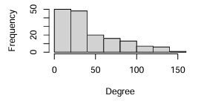
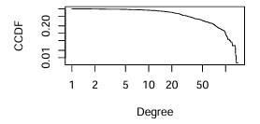
Degree distribution
The general graph has a degree distribution that seems to be a power law.
A lot of nodes with low degree and few nodes with high degree.
The CCDF (Complementary Cumulative Distribution Function) on a log-log scale of a power law distribution is a straight line.
The one of the general graph is not a line, but for medium-high degree values is similar to a straight line.
Degree distribution of the general graph
CCDF of the general graph

Slide 10
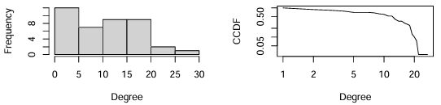
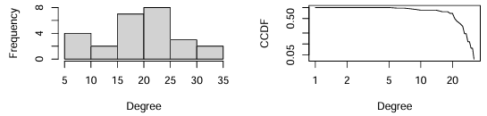
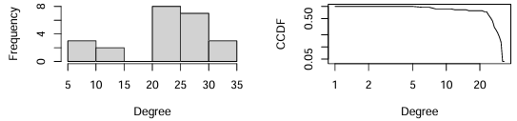
Degree distribution
Even for the degree distribution I analyzed only a sample of the annual graphs, this time I took the first, the one in the middle and the last one.
In the graph of the 1994 season the distribution is similar to what we saw in the general graph, but less defined.
In the other 2 graphs for sure the distribution is not a power law, but it is more similar to a poisson distribution (more visible in the 2007 season).
Degree distribution and CCDF of the 1994 season
Degree distribution and CCDF of the 2007 season
Degree distribution and CCDF of the 2020 season

